Slide 1
State of the Project
Matt Ahrens

Slide 2

OZDS 2020
Thank you Karyn Ritter!
Project Management
Thank you Victoria Faveau!
Event Management
Thank you Pavel Zakharov & Paul Dagnelie!
Speaker-herders
Thank you Aaron Holding!
Graphic design
Thank you Prakash Surya & Ali Oriqat!
Tech/IT help

Slide 3

Thank you Diamond Sponsors!

Slide 4
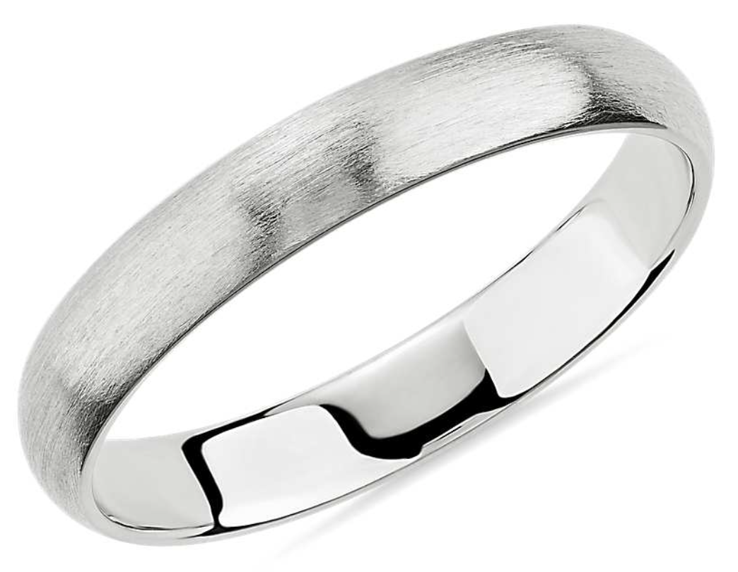

Thank you Platinum Sponsors!

Slide 5



Thank you Gold Sponsors!

Slide 6





Thank you Silver Sponsors!
Thank you Bronze Sponsors!

Slide 7
Thank you Pandemic Sponsors!

Slide 8


Slide 9
Next Major Release
OpenZFS 2.0, for Linux and FreeBSD
Coming in 2020, still!
(2.0rc3 is out now)

Slide 10
New features in OpenZFS 2.0 (since ZoL 0.8)
FreeBSD support!
Performance enhancements
Fast clone deletion (OZDS 2017)
Log Spacemap (OZDS 2017)
Metaslab performance (OZDS 2019)
Some send/receive performance (OZDS 2020)
Redacted send/receive (OZDS 2015)
zpool wait
Persistent L2ARC (OZDS 2020)
Sequential resilvering (OZDS 2020)
ZSTD compression
Sectional zfs/zpool manpages (one per subcommand) (OZDS 2019 hackathon)

Slide 11




OpenZFS 3.0?
Goal: ~yearly major releases of OpenZFS (3.0, 4.0, 5.0, etc)
Jorgen Lundman is working on adding OSX support
OpenZFS for
Linux &
FreeBSD
& OSX

Slide 12

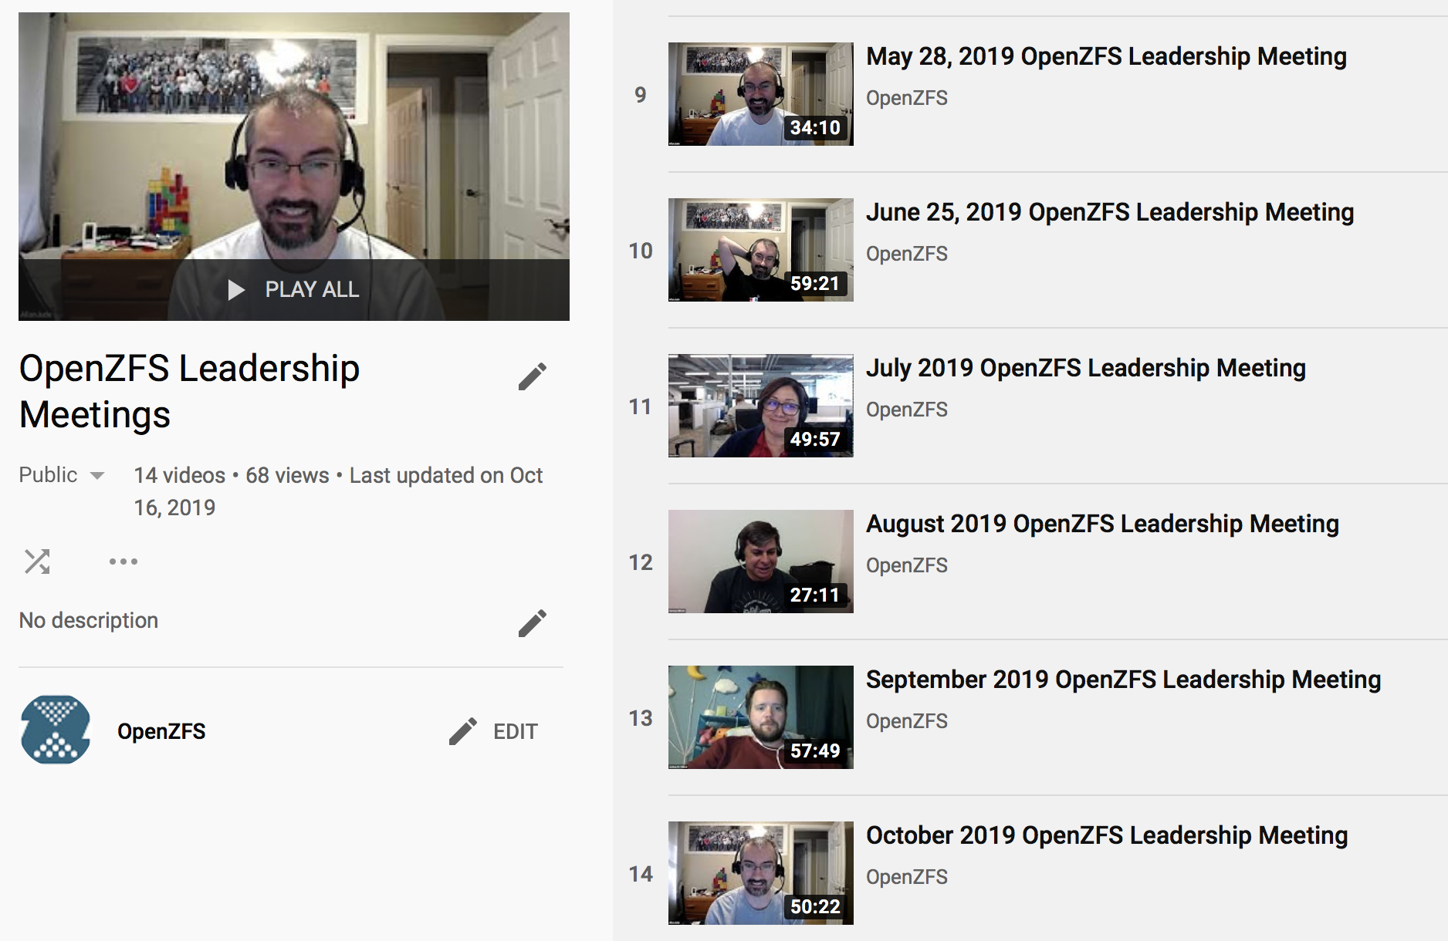
Next meeting: Tuesday
October 13, 9AM Pacific
Zoom link in agenda gdoc
Notes:
New since last year: Monthly video calls
Talk about proposed new features, how to move PR’s forward, etc.
Recordings on youtube
Detailed meeting notes in google doc
Join us for this month’s meeting, which is next week
Jason King’s talk “Securing the cloud with ZFS encryption” at next meeting

Slide 13
OpenZFS Code of Conduct
https://openzfs.org/wiki/Code_of_Conduct
Conduct Problems?
conduct@openzfs.org
matt@mahrens.org
karyn.ritter@delphix.com
Technical Problems?
prakash.surya@delphix.com
Email or find us on the OpenZFS slack

Slide 14
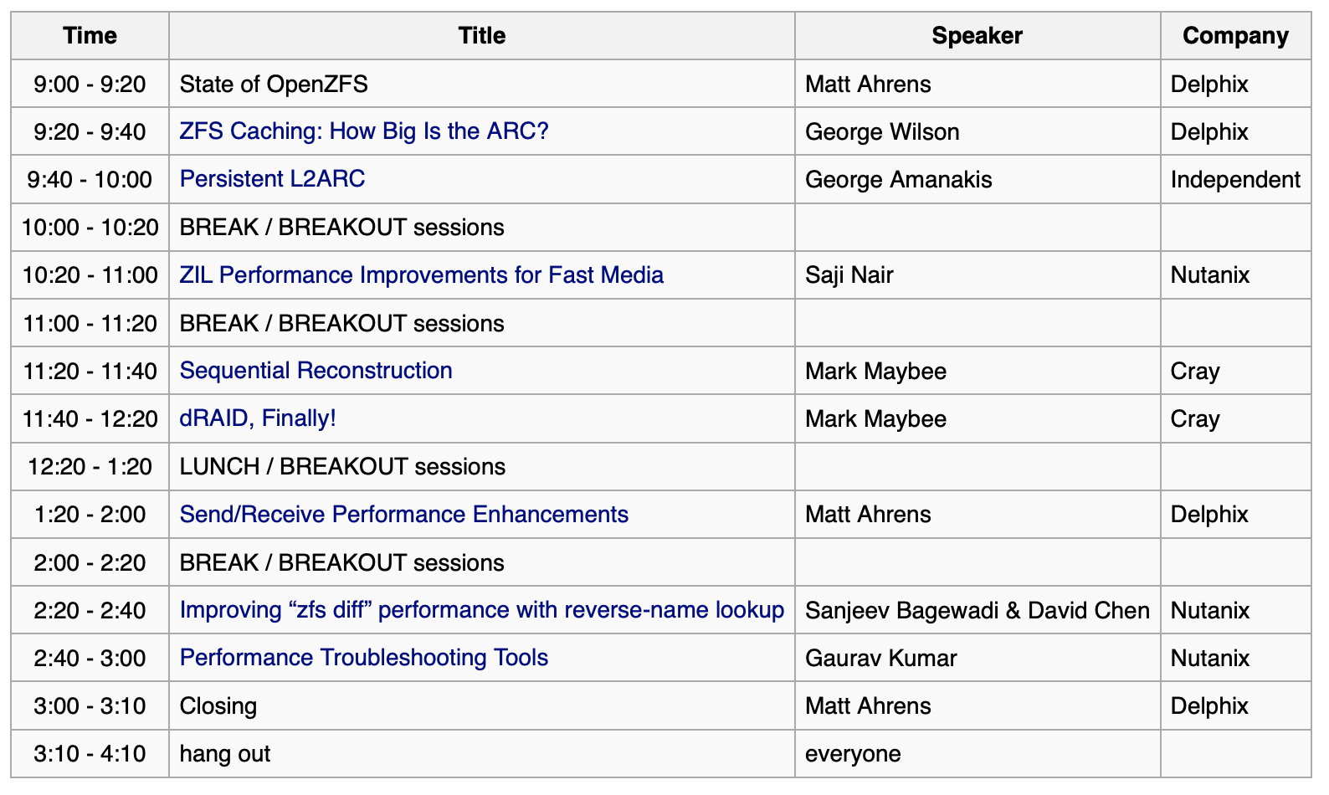
Schedule on openzfs.org

Slide 15
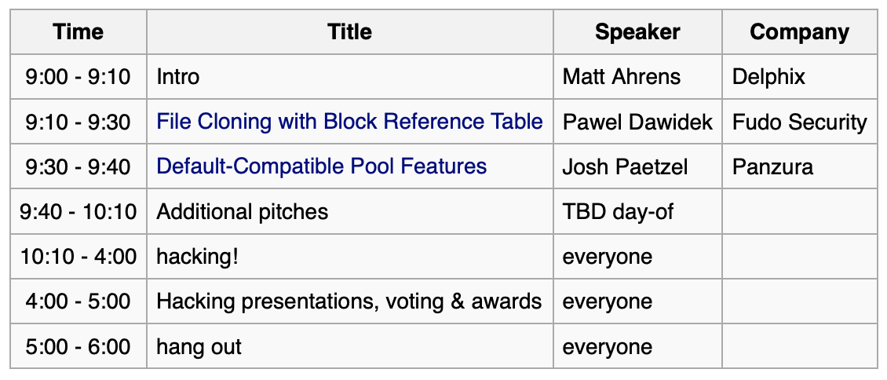
Hackathon tomorrow! (Pacific time)

Slide 16
Questions!

